Slide 1
Test Plan

Slide 2
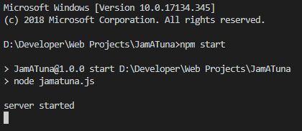
Run Server
Run the following commands in the project directory
npm install
npm start

Slide 3
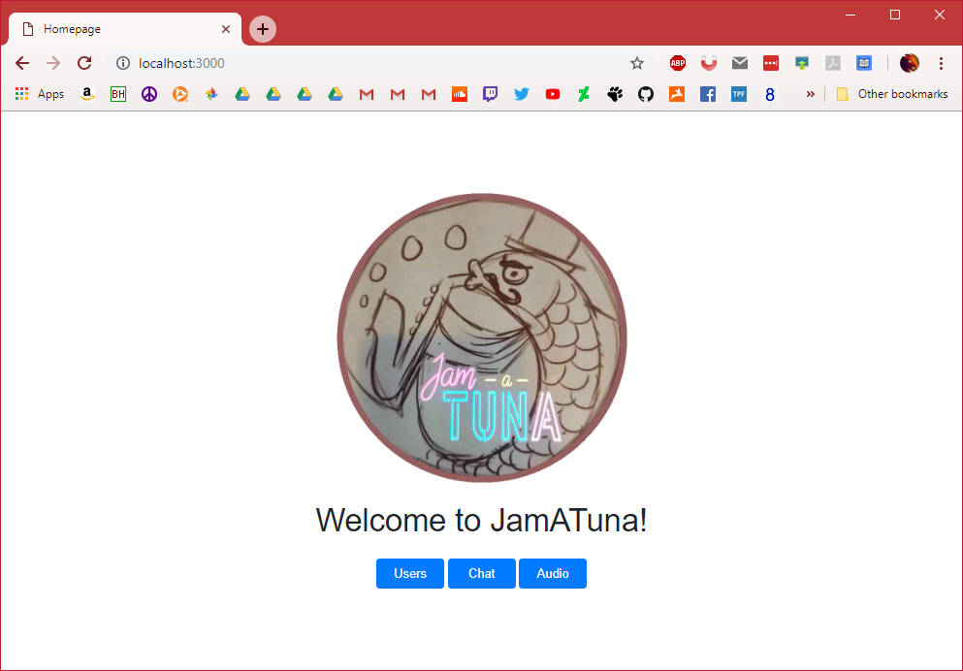
Home page
Navigate to http://localhost:3000/
Should see Jam-a-Tuna image, text, and buttons
All buttons should work by taking you to a new page
Page should be centered in middle of browser

Slide 4
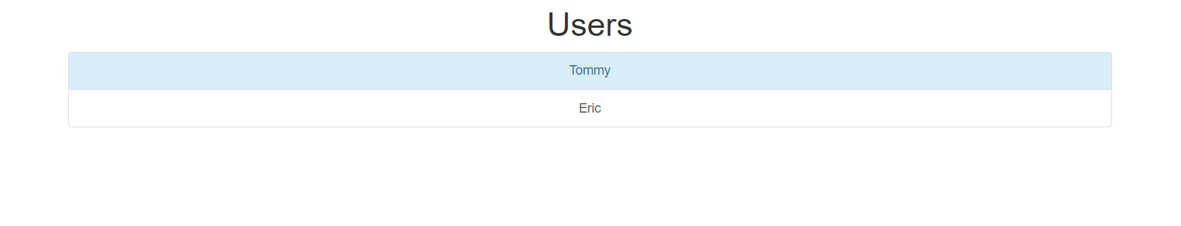
Users page
Click “Users” button on home page.
Should navigate to http://localhost:3000/html/users.html
Should see list of users
Each user should be clickable
Odd-numbered entries should have a light-blue background.

Slide 5
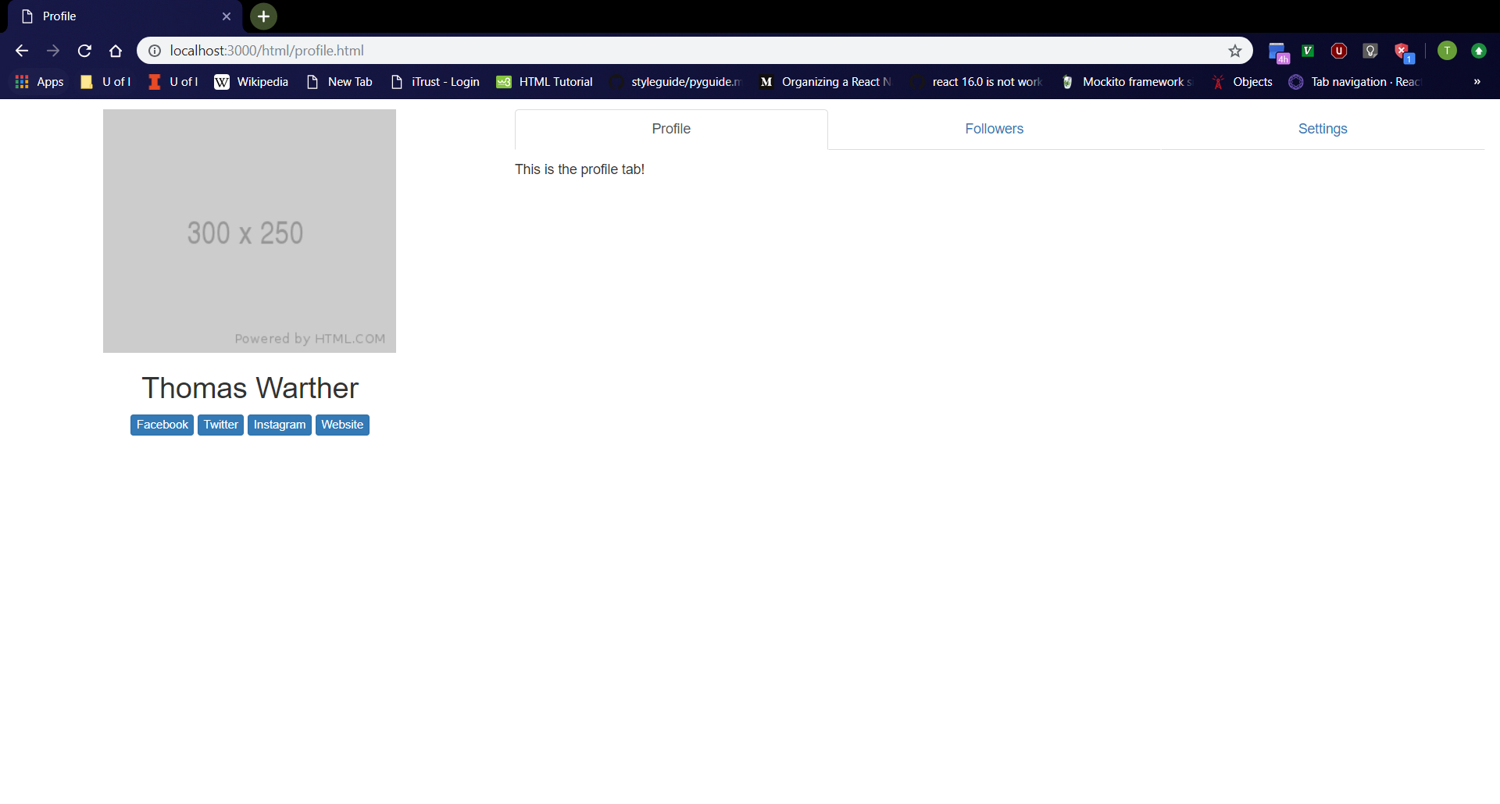
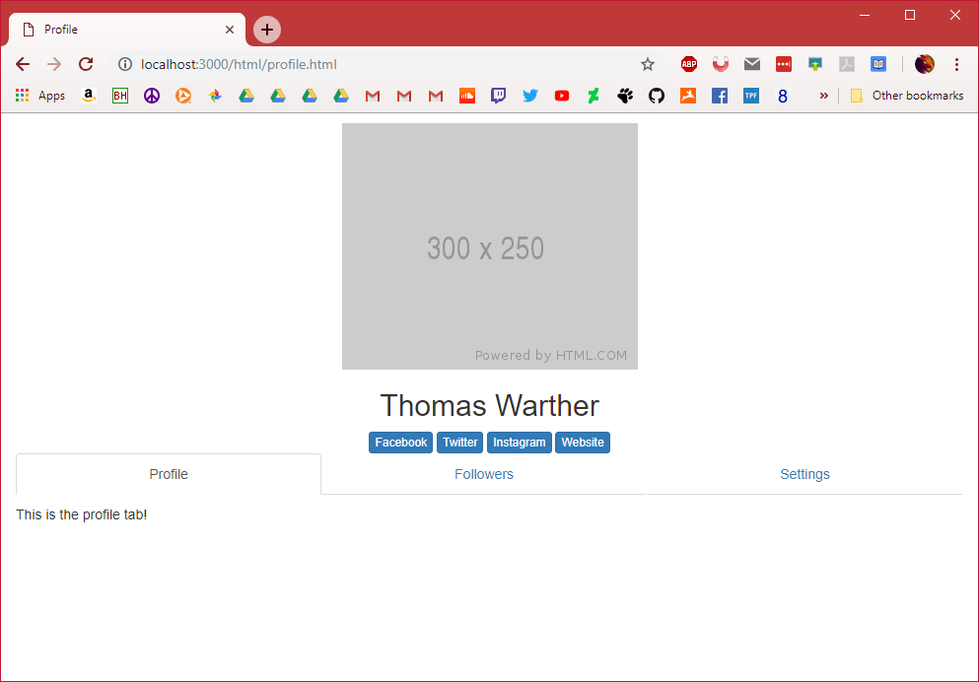
Profile page
Navigate to http://localhost:3000/html/profile.html
Should see profile page with tabs
Tabs are clickable

Slide 6
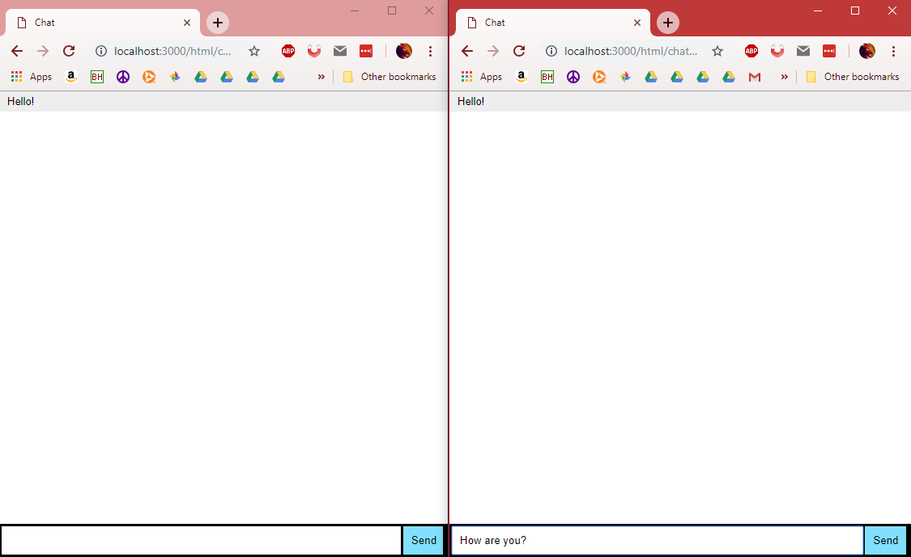
Chat page
Navigate to http://localhost:3000/html/chat.html
Open two browser tabs
Type messages into either tab and hit ‘Enter’
Messages should show on both tabs

Slide 7
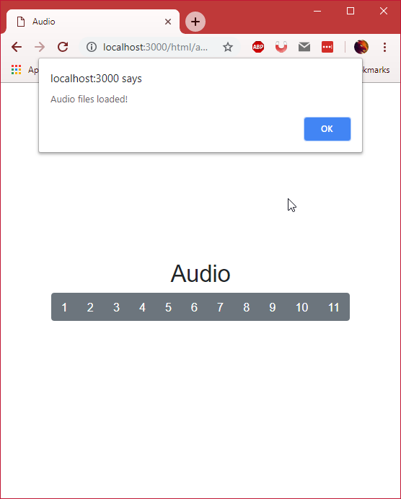
Audio page
Navigate to http://localhost:3000/html/audio.html
Should see title and buttons centered in screen
A message should appear telling you that the audio files have been loaded

Slide 8
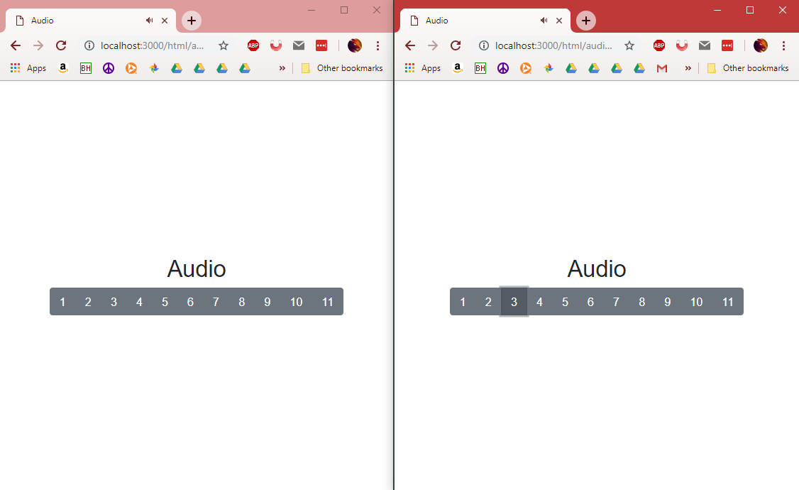
Audio page
Continued
Pressing a button on either tab will play an audio file
Audio files should be played on both tabs
Sound should be in sync no matter how irregular clicks are made

